Slide 1
Positive Psychology
Martin Seligman: “scientific study of optimal human functioning [that] aims to discover and promote the factors that allow individuals and communities to thrive”.

Slide 2
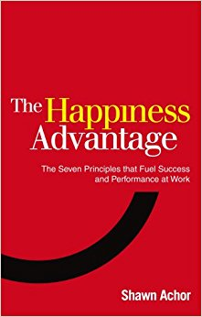
Purpose of project
To support young people in understanding and developing ways to help them and others thrive.
Shawn Anchor – inspired by a TED talk – check it out

Slide 3
Purpose of presentation
To share some examples of positive psychology in action and how you might share this with young people.
Young people are not problems to be solved, they are potentials to be unleashed.

Slide 4
Starter activities and homework
Positive rumours
Mirror neurons
The “thinker” and the “jumper”
Post-traumatic growth
What comes first, Happiness or Success?
Hmk - random acts of kindness, mirroring

Slide 5
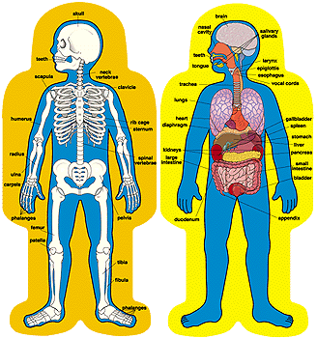

Slide 6
What is mental ‘health?’
Discuss this with your partner…

Slide 7
What is ‘mental health?’
World Health Organization
‘Mental health is defined as a state of well-being in which every individual realizes his or her own potential, can cope with the normal stresses of life, can work productively and fruitfully, and is able to make a contribution to her or his community’.

Slide 8

Wellness continuum
- How would you label each section?
- Where would you place yourself?

Slide 9
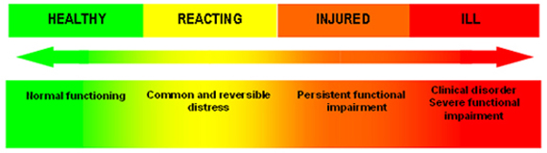
Discussion as moving up and down

Slide 10
Why happiness? The power of the mind
Jelly at lunch
Give the doc a lollipop
Turning back the clock
Placebo effect
Happiness ----------------------------→Success
Does school teach the opposite? Do we as professionals?

Slide 11
Why focus on strengths?
…“a particular way of behaving, thinking, or feeling that is energising to the user, and enables optimal functioning, development and performance”
Happiness ----------------------------→Success
Does school teach the opposite? Do we as professionals?

Slide 12
The Losada Line
Activity…
What ratio of positive to negative interaction makes for the most successful teams?

Slide 13
The Losada Line
Answer… 2.9013
A decade of research
For example, global company making 10% losses changed it’s ratio from 1.15 to 3.56 and showed 40% increase in production

Slide 14
The Losada Line
Individuals above the Losada Line tend to be more happy, productive, creative and innovative
Ideal = 6-1 ratio
Barbara Frederickson (Education)
Happiness --------------------→ Success

Slide 15
Post-traumatic growth – “Falling Up”
After a crisis or something that does not go well, there are three mental paths:
  1) the negative event creates no change
  2) you are worse off after the negative event
  3) The Third Path… we are stronger and more capable than before

Slide 16
Post-traumatic growth – “Falling Up”
  The Third Path = “the difference between those who are crippled by failure and those who rise above it”.
  …“we are not imprisoned by our circumstances, our setbacks, our history, our mistakes, or even staggering defeats… we are freed by our choices”.

Slide 17
Post-traumatic growth – “Eureka, we failed”
Walt Disney – fired by a newspaper for not being creative enough.
Michael Jordan – kicked out of college Basketball team.
Do you know any examples?

Slide 18
Post-traumatic growth – “Learned helplessness”
Dog study
Human study
When people feel helpless in one avenue of life, this tends to move into others…

Slide 19
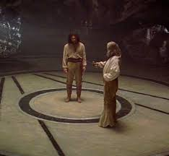
Zorro Circle?

Slide 20
Zorro Circle
    “FEELING THAT WE ARE IN CONTROL, THAT WE ARE MASTERS OF OUR OWN FATE AT WORK AND HOME, IS ONE OF THE STRONGEST DRIVERS OF WELL-BEING AND PERFORMANCE”.
    This is more about how much control we think we have rather than how much we actually have.

Slide 21
Structure of project
Session 1 – what is well-being and mental “health”(NOT ill-health)
Session 2 – myth busting – what are diagnoses? Why are the benefits of happiness?
Session 3 – The “Losada Line”
Session 4 – The “Zorro Circle”
Session 5 – “Falling up”

Slide 22
It’s summer time
What things can you do to move in this direction ◄◄◄◄

